Slide 1
Mini Project on Used cars
Project layout.
Data set Description
Data Manipulation
Statistical
Analysis
Raw Data cleaning
Exploratory Data Analysis

Slide 2
Data Set Description The Data set comprises of total 7,907 Rows & 19 columns, information contain about the used cars
About the Case Study
There is an automobile company XYZ ltd are willing to enter the Used- car market in each and every Regions, State or Provinces of United State of America.
The Data is from the year 1994 to 2020 which comprises of several factors which required for analysing before selling the used car to the customers. They want to understand the factors affecting the prices of used car in compression of the New cars. Based on various market surveys, the consulting firm has gathered a large dataset of different types of used cars across the market.

Slide 3
Business problem Understanding & Descriptions
After analyzing the data set, about (75%) used car are unsold and (25%)
Used car has been sold across all the Regions.
If we go by numerical values, out of 7,906 (numbers) only 2,000(numbers) of used car has been sold and 5,906(numbers) are unsold.
As year of the Used cars starting from 1994 , hence we have polluted the No.of years
i.e.(current year- Purchased year) which help to understand that how many years car has been used.
And also there was the key factors like kilometer driven, brands etc in terms of “selling price” of the used car which is also the main objective of these particular project.
Approach to the solutions
The classification of the cases will be performed by using Data Manipulation , Statistical Analysis
Exploratory Data Analysis . Jupyter Notebook & excel will be used as an IDE for the Project.
As our target is selling price hence I have considered only the sold car, hence the prediction has only done on the
Basis of sold car not on the total used cars( i.e. Sold + Unsold).

Slide 4
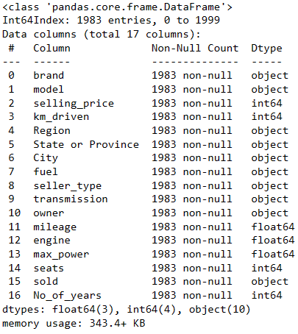
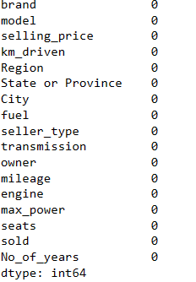
Basic info about the Data set
Here we can see the was column ‘No_of_years’. It has been calculated on the basis of year that car has been purchased till the current years.(i.e ‘current year- purchased year).
As per the data set there was a column ‘name’ which includes Brand name along with model of the car has been modified and separated into two column ‘brand’ & ‘model’
Along side there was few duplicates data found in the given data set which has been dropped Out.
After sanitary check on the given data set we found zero null values.

Slide 5

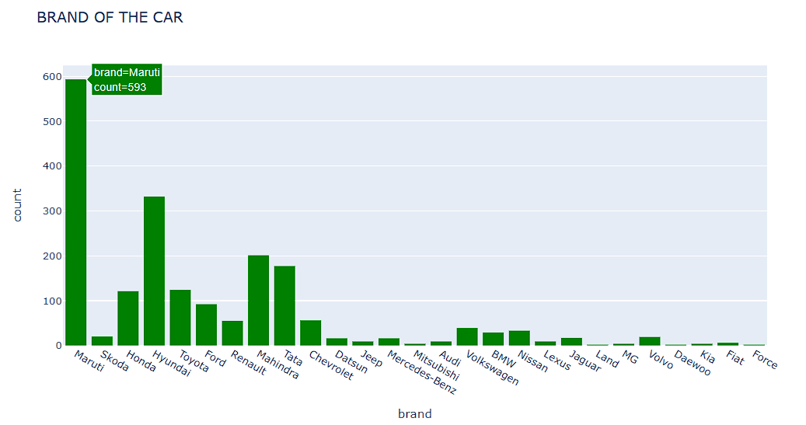
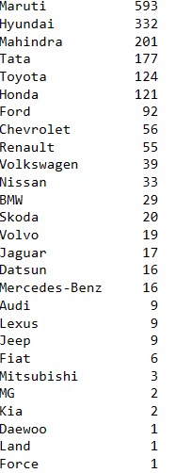
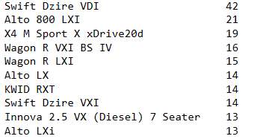
Brand & Model Name of the used cars
There are total 27 unique car companies . Brand of the companies will not effect the car price, rather the price will be depend on how many years it has been used , Km driven etc.
Here are the counts of brand sold in in each & every region of the country.
Below are the Top 10 sold used car models in each & every region of the country

Slide 6
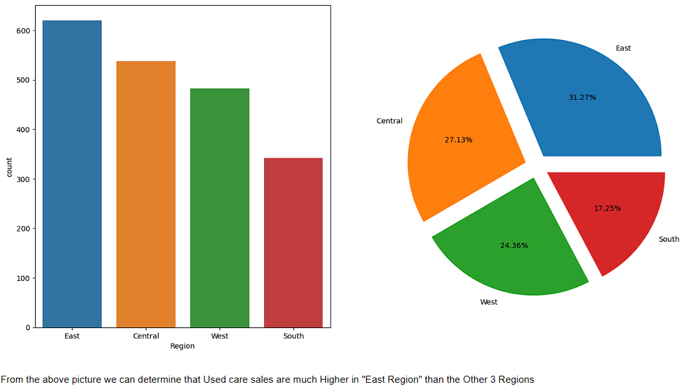


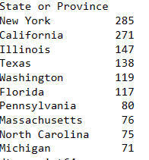
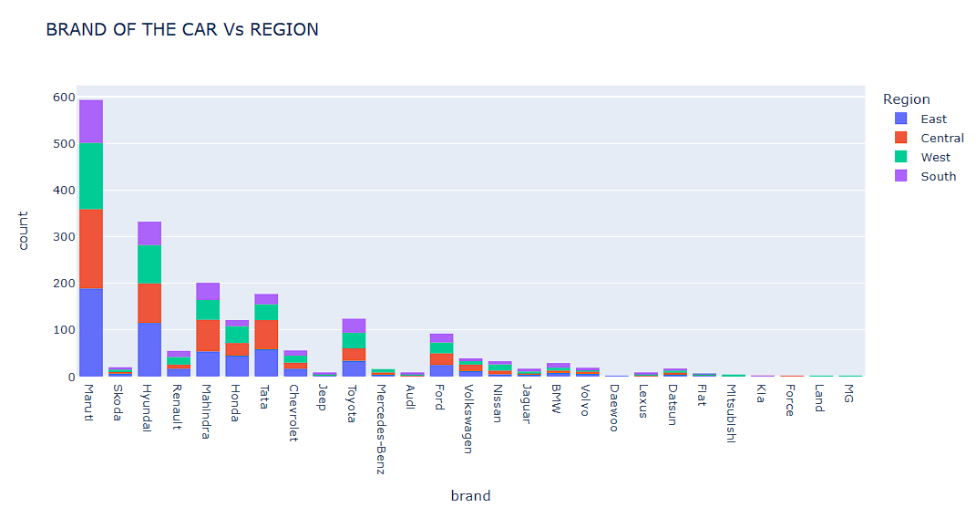
4 Regions where the Used Care sales has been done
As per the numbers & percentages of Used car sold in four different regions of USA
Here we can see the Top 10 state or provinces where used car mostly sold

Slide 7


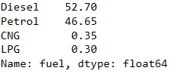

Analysis on the basis of some Statistics.
Buyer's Prefer more manual transmission than Automatic which is 86%
Maximum numbers of the Used care are sold by the Individual Which is 82%
Most of the used car are running with Diesel which is 53%
Used car sold maximum by the First Owner which is 66%

Slide 8
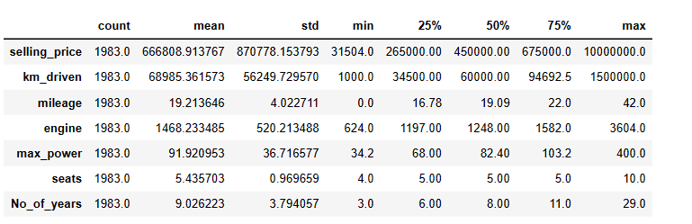
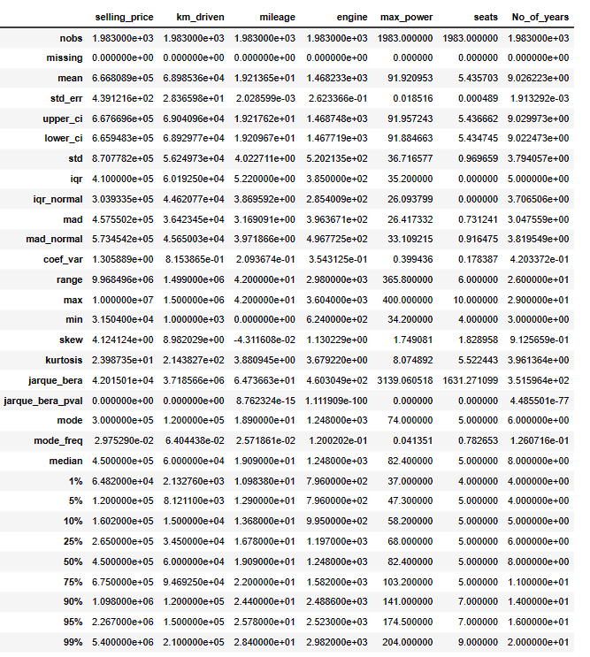
Five Point Summary & Descriptive statistics
On the above statistical description of given dataset, we make conclusion
1.The average car has been driven near about 60,000(sixty thousands ) km, the maximum car has been driven near about 15,00,000(Fifteen lakhs ) km and the minimum car has been driven is 1000 km.
2.The maximum selling price of a used car is $1,00,00,000(One crores), the average selling price is $ 4,50,000(Four lakh Fifty thousands) & the minimum selling prices $ 31,504(Thirty One Thousands Five Hundred and Four)
3.Maximum number of years that the car has been used is 29 years , the average number of years is 8 & minimum numbers of years is .

Slide 9
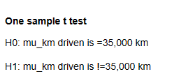
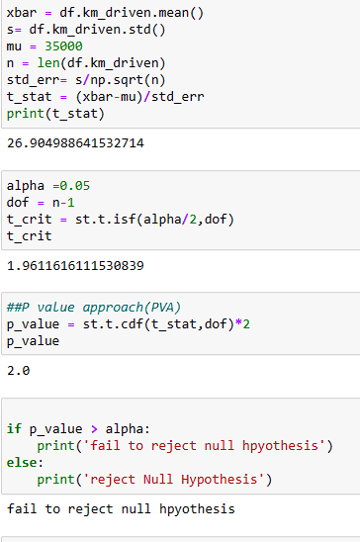
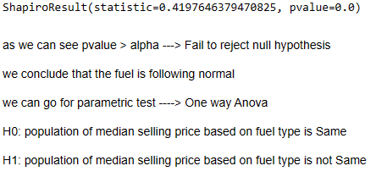
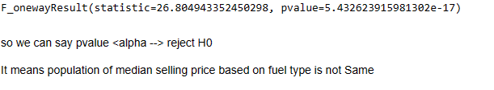
Hypothesis Testing
The automobile company owner claim that
In both the situation the level of significance is 5%
1. the average total km driven 35000 km
2. Does fuel effect the selling price
One Way Anova
We can say that fuel effect the selling price is false
We can say that the average total km driven 35000 km is true.

Slide 10
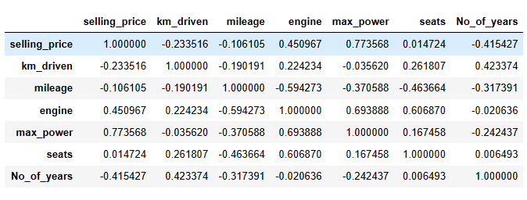
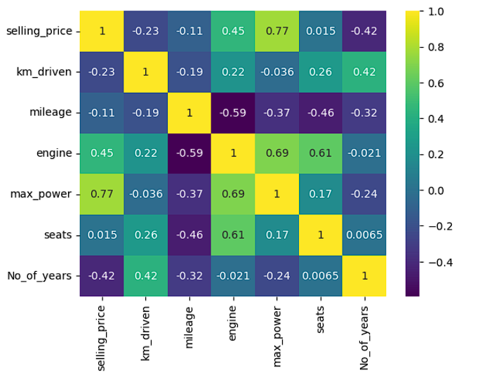
Predicting the Price of Used Car by Exploratory Data Analysis
We can conclude that there was a
1.positive correlation & coefficient between selling price & max power
2.positive correlation & coefficient between engine & maxpower
3.positive correlation & coefficient between km_driven & No_of_years.
4. Negative correlation & coefficient between mileage & engine.
So from the heatmap or the data we can say that there was high positive correlation between selling price and maximum power where as there was also negative correlation .

Slide 11
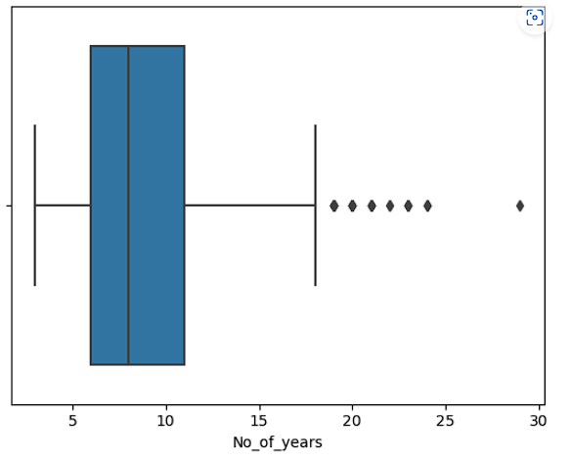
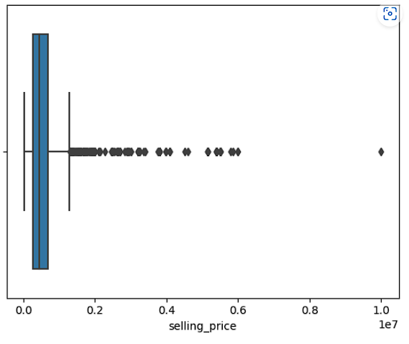
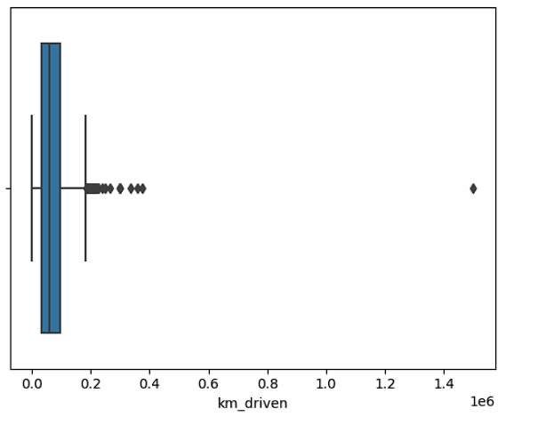
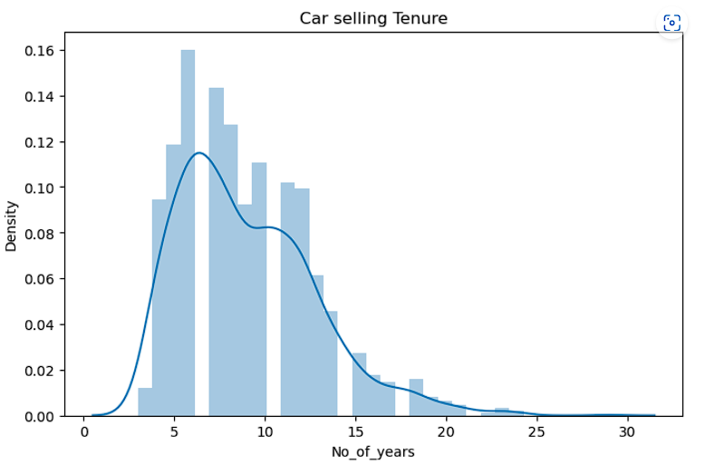
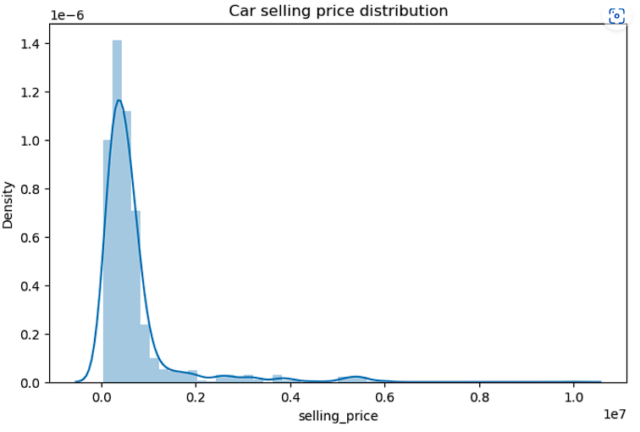
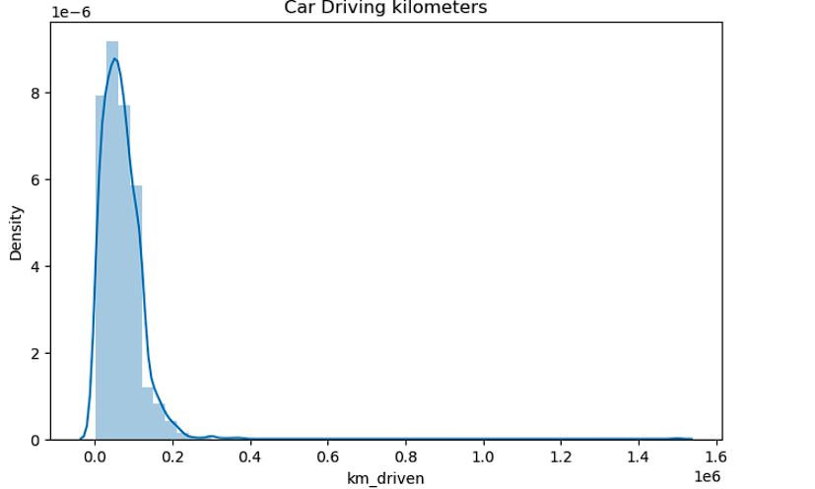
Let’s Check some of the Outliers
From the above diagrams we can conclude that:-
There was a clear outliers in ‘No of Years, selling price & km driven’.
Most of the cars sold which has been used between 3 to 12 years & As there was highest car used (which is 29 years) and sold , so there was the Outliers.
We can see that selling price of a used car is lying most between 1 to 20, lakhs. As the maximum price of the used car is 1 crore ,there was outliers.
Hence we see it is Right Skewed in every aspect & also the outliers. So need to performed the Quantile method.

Slide 12



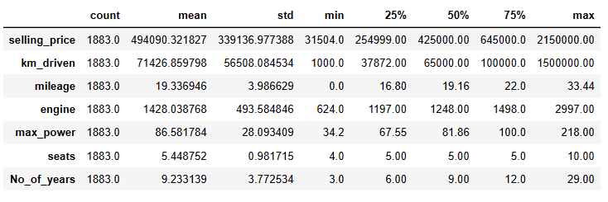
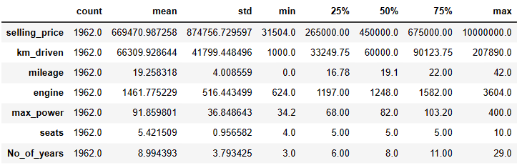
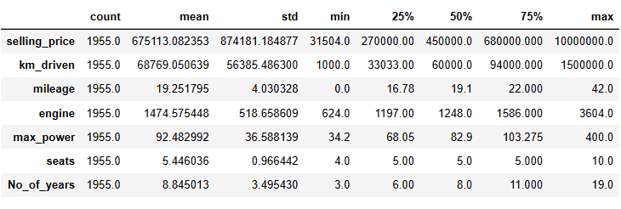
Using IQR method
IQR on Selling price
IQR on km driven
IQR on No of years
As we can see the outliers are high, it is not good idea to drop the outliers we can capping the outliers at maximum 95% & at minimum 5%
After cleaning & Capping the Outliers on selling price, km driven & No. of years
The maximum selling price of a used car is $21,50,000(Twenty One lakhs & Fifty Thousands), the average selling price is $4,25,000(Four lakh Twenty Five thousands ) & the minimum selling price is $ 31,504(Thirty One Thousands Five Hundred and Four)
The maximum km driven by a used car is 2,07,890 km(Two lakhs seven thousands Eight hundreds and Ninety ), the average km driven is 60,000 km (Sixty thousands ) & the minimum km driven is $ 1,000 km(One Thousands)
The maximum No of Years of a used car is 19 years , the average No of Years of a used car is 8 years & the minimum No of Years of a used car is 3 years.

Slide 13
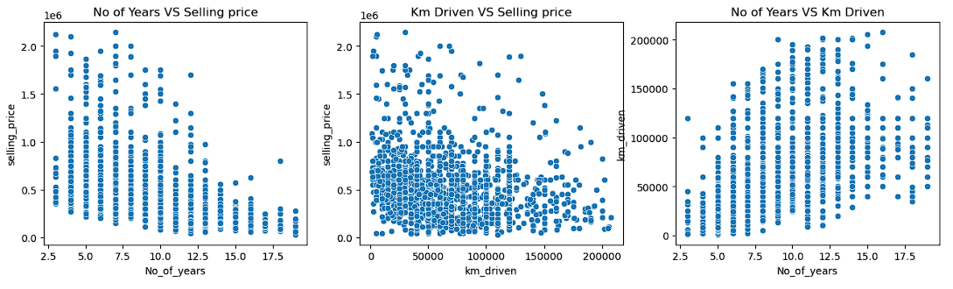
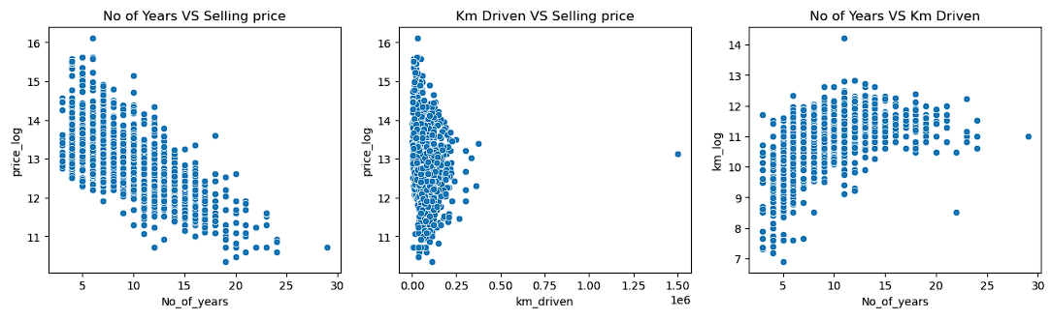
Scatterplot & Transforming the Data
After Capping outliers
Transforming the Data into log
We can see by these two diagram that
Selling price is higher when Use of the car is in between 3 to 12 years in both the After & Before Capping Outliers
Selling Price is also higher when there is less amount of kilometers Run in both the After & Before Capping Outliers.
Maximum Kilometers run by the used car is between 3 to 15 years.

Slide 14
Inferences
After review all the insights of the above scenario we come across
Sales of the used car is more in the Eastern region & New York city.
As per the brand concern Maruti is the highest selling brand in compression to other brands.
With the help of statistics we came across the dependent variable that affects the selling prices.
Also we find out the correlation & coefficient in terms of selling price.
On the basis of all the diagrams & the statistical data ,
Selling price of used car is depending on the Kilometre driven and Number of Years the car has been used
The other factors like transmission , fuel, mileage, engine etc also influence in the selling price of the used cars
But every aspect is depending upon the how many kilometres driven and the number of years used.
So we can say that the car which has been used with in 3 to 12 years with average kilometres driven has the maximum selling price as well as maximum number of sales.

Slide 15
Thank You

